Slide 1
Data Science
What is Data Science and Who is Data Scientist
Denis Reznik
Data Architect at Intapp Kyiv

Slide 2
About me
Denis Reznik
Data Architect at Intapp, Inc.
Microsoft Data Platform MVP
Co-Founder of Ukrainian Data Community
Father of a boy :)
2 |

Slide 3
Agenda
What is Data Science?
Who is Data Scientist?
Discover some info about Data Scientists using Data Science

Slide 4
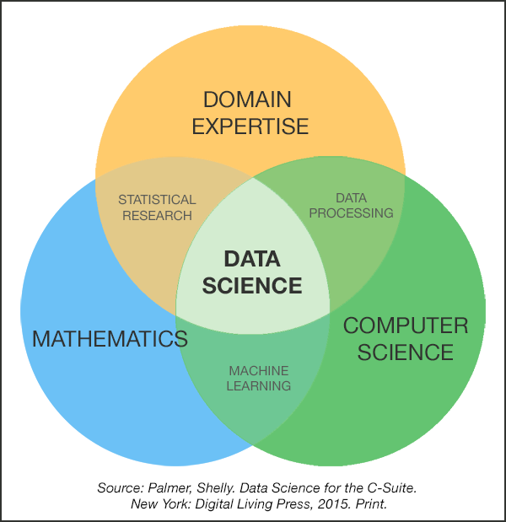
Data Science

Slide 5
Data Science is a new term. But in the same sense as Columbus was discovered NEW continent 1000 years ago
(c) Hector Garcia-Molina.
Professor in the Departments of Computer Science and Electrical Engineering at Stanford University

Slide 6
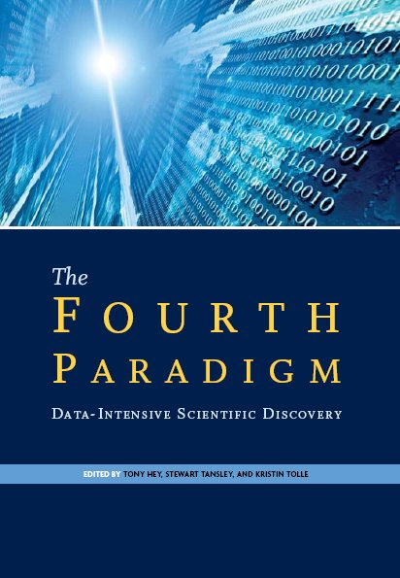
Fourth Paradigm of Science
Thousands of years
Empirical
Few hundreds of years
Theoretical
Last fifty years
Computational
“Query the world”
Last twenty years
eScience (Data Science)
“Download the world”

Slide 7
Data Science and Others
Business Intelligence
Statistics
Data(base) Management
Visualization
Machine Learning
Data Mining
Artificial Intelligence
Big Data

Slide 8
Big Data Science Tasks
Facebook
Amazon
Google
LinkedIn
Netflix
Rozetka
Microsoft

Slide 9
Regular Data Science Tasks
Data analysis
What percentage of users back to our site?
Which products usually bought together?
Modeling/statistics
How many cars we are going to sell next year?
Which city is better for opening new office?
Engineering/prototyping
Product to use a prediction model
Visualization of analytics

Slide 10

Human
VS.
Machine

Slide 11
Human vs. Machine
Human
Naturally can work with small amount of data
Have a knowledge about domain
Good image recognition
Machines
Can make intensive computations
Knows only numbers and strings (well, actually only numbers)

Slide 12
A data scientist is the adult version of the kid who can’t stop asking “Why?”
(c) Russ Thompson
Senior Research Scientist at Alexa

Slide 13
A data scientist is a statistician who lives in San Francisco
(c) somebody

Slide 14
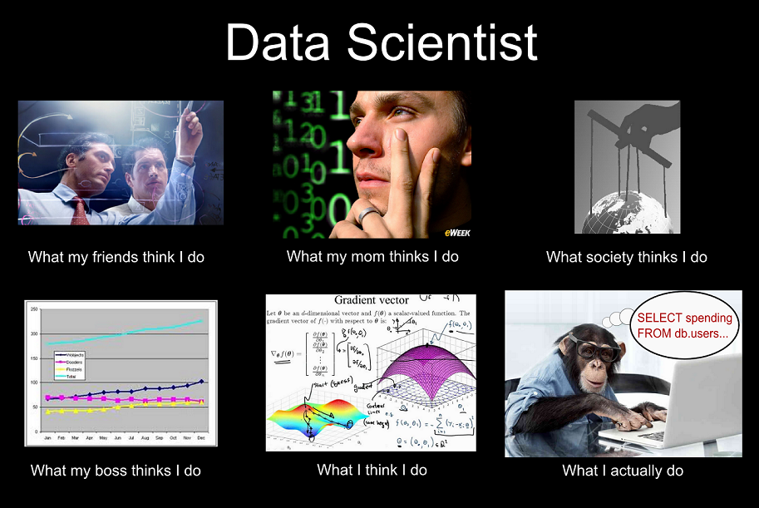

Slide 15
Data Scientist vs Software Professional
Both terms are very wide

Slide 16
Who is Data Scientist?
Scientist
Someone who find new discoveries
Make a hypothesis
Investigate that hypothesis
Data Scientist
Do the same with data
Look for meaning, knowledge in the data
Answering questions and rely on data

Slide 17
Data Science

Slide 18

Data Scientist is the sexiest job of 21st century (c) Harvard Business Review
Oh, Really?

Slide 19
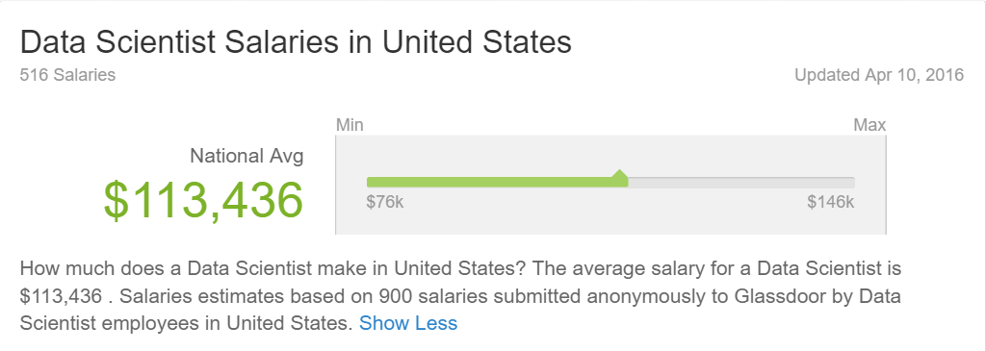
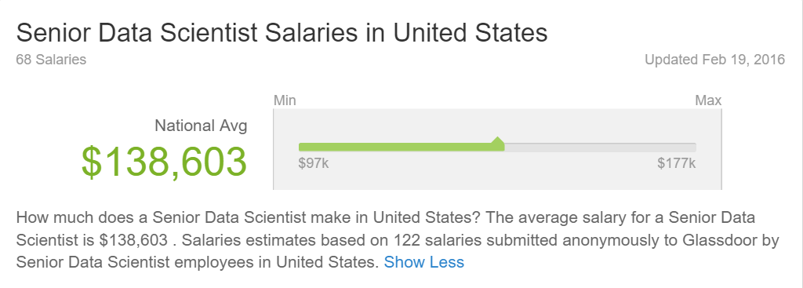

Slide 20
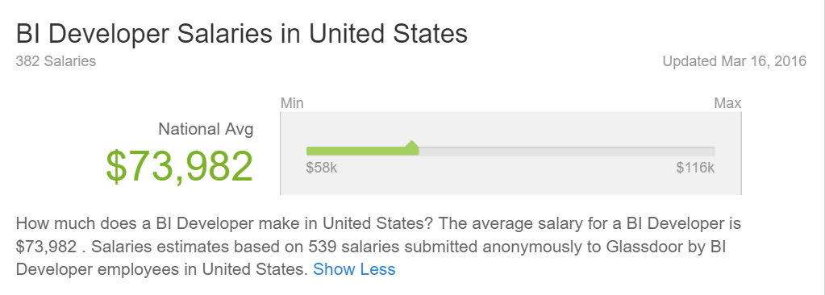
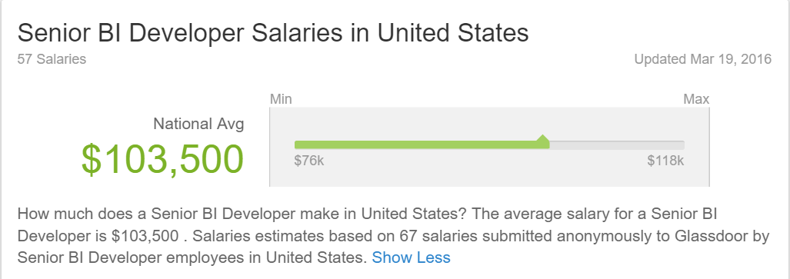

Slide 21
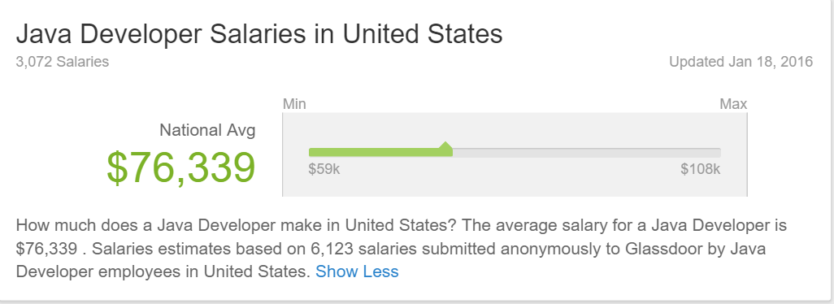
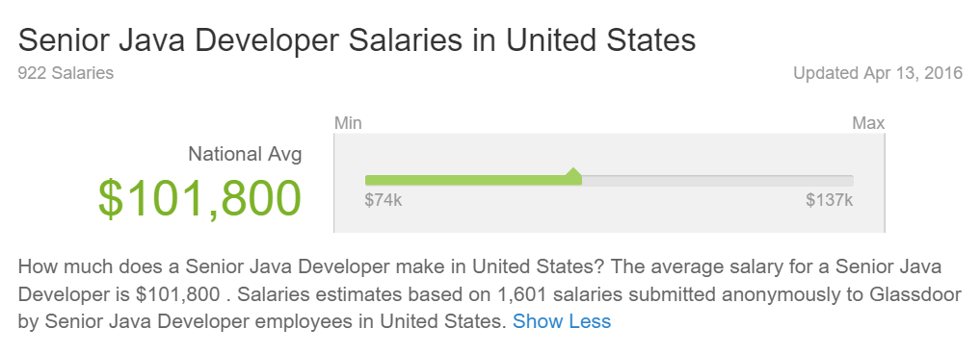

Slide 22
Data Dilemma
Cost vs. Value
How much Value can I extract from the data?
How much it will cost to me to store that data?
Big Data
No individual record is particularly valuable
Having every record is incredibly valuable

Slide 23
Data Science Project
Should have a goal (aka Problem)
How many customers will buy this car next month?
Which capacity should I reserve for my database growth? (well, I’ve just discovered that my everyday job become a Data Science problem)
In which city should I open the office?
Result
Prototype of a working algorithm
Deploy prediction model to use on a daily basis
Visualize trends
Find hidden correlations between parameters

Slide 24
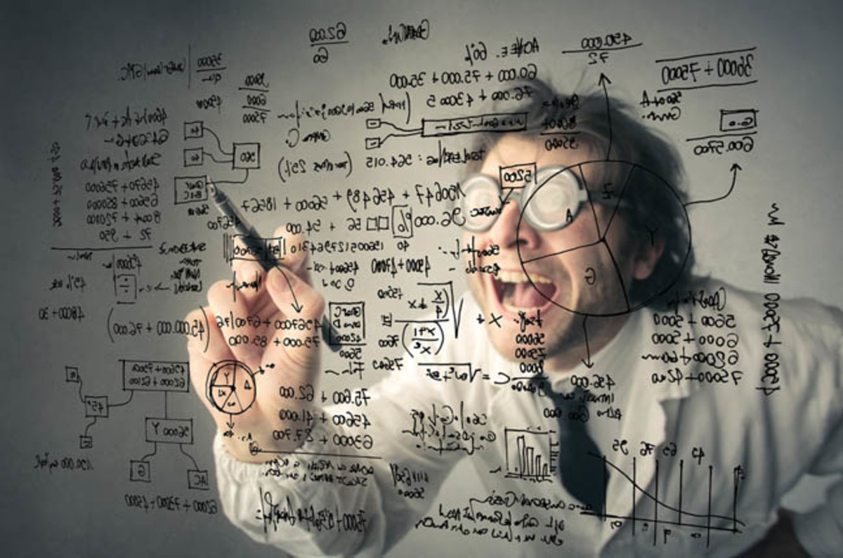
Let’s do some Data Science

Slide 25
Where to Learn?
University
Online Resources
Coursera
Pluralsight
Etc.
Books

Slide 26
How to start?
Your own company
Open competitions (Kaggle)

Slide 27
Summary
What is Data Science?
Who is Data Scientist?
Discover info about Data Science using Data Science

Slide 28
Resources
The Fourth Paradigm
Cloudera: Training A New Generation Of Data Scientists
The Future of Data Science - Data Science @ Stanford
Coursera: Data Manipulation at Scale
Coursera: Machine Learning
Understanding Data Science and Why It’s So Important
Data Scientist: The Sexiest Job of the 21st Century

Slide 29
Thank you!
Denis Reznik
Twitter: @denisreznik
Email: denisreznik@live.ru
Blog: http://reznik.uneta.com.ua
Facebook: https://www.facebook.com/denis.reznik.5
LinkedIn: http://ua.linkedin.com/pub/denis-reznik/3/502/234

